Slide 1
EMPLOYEE SALARY PREDICTION
CAPSTONE PROJECT
Presented By :
SHAHRUKESH DM – K.RAMAKRISHNAN COLLEGE OF TECHNOLOGY, TIRUCHIRAPPALLI - CSE

Slide 2
Problem Statement
Develop a machine learning model to predict employee salaries.
Use factors : Age, Gender, Education Level, Job Title, Years of Experience.
Goal : Assist HR in salary benchmarking and workforce planning.
Deploy as a user-friendly Streamlit web app for transparency and fairness.

Slide 3
System Approach
Hardware : Computer with 8GB+ RAM, multi-core processor.
Software : Python 3.8+, Streamlit, Jupyter Notebook.
Data : employee_salary.csv (Age, Gender, Education, Job Title, Experience, Salary).
Environment : Python with pip or conda
Interface : Streamlit app for user inputs and predictions.
Libraries Required : Pandas, NumPy, Scikit-learn, Joblib, Streamlit, Mathplotlib / Seaborn

Slide 4
Algorithm & Deployment
Preprocessing :
• Clean dataset, remove nulls, convert Salary to numeric.
• Create Exp_to_Age feature (Experience / Age).
Model Development :
• Random Forest Regressor in a Pipeline.
• Scale numerical features, encode categorical features.
• Train on 80% data, test on 20%.
Deployment :
• Streamlit app with sliders/dropdowns. Load model and dataset for predictions. Deploy locally or on Streamlit Cloud.

Slide 5
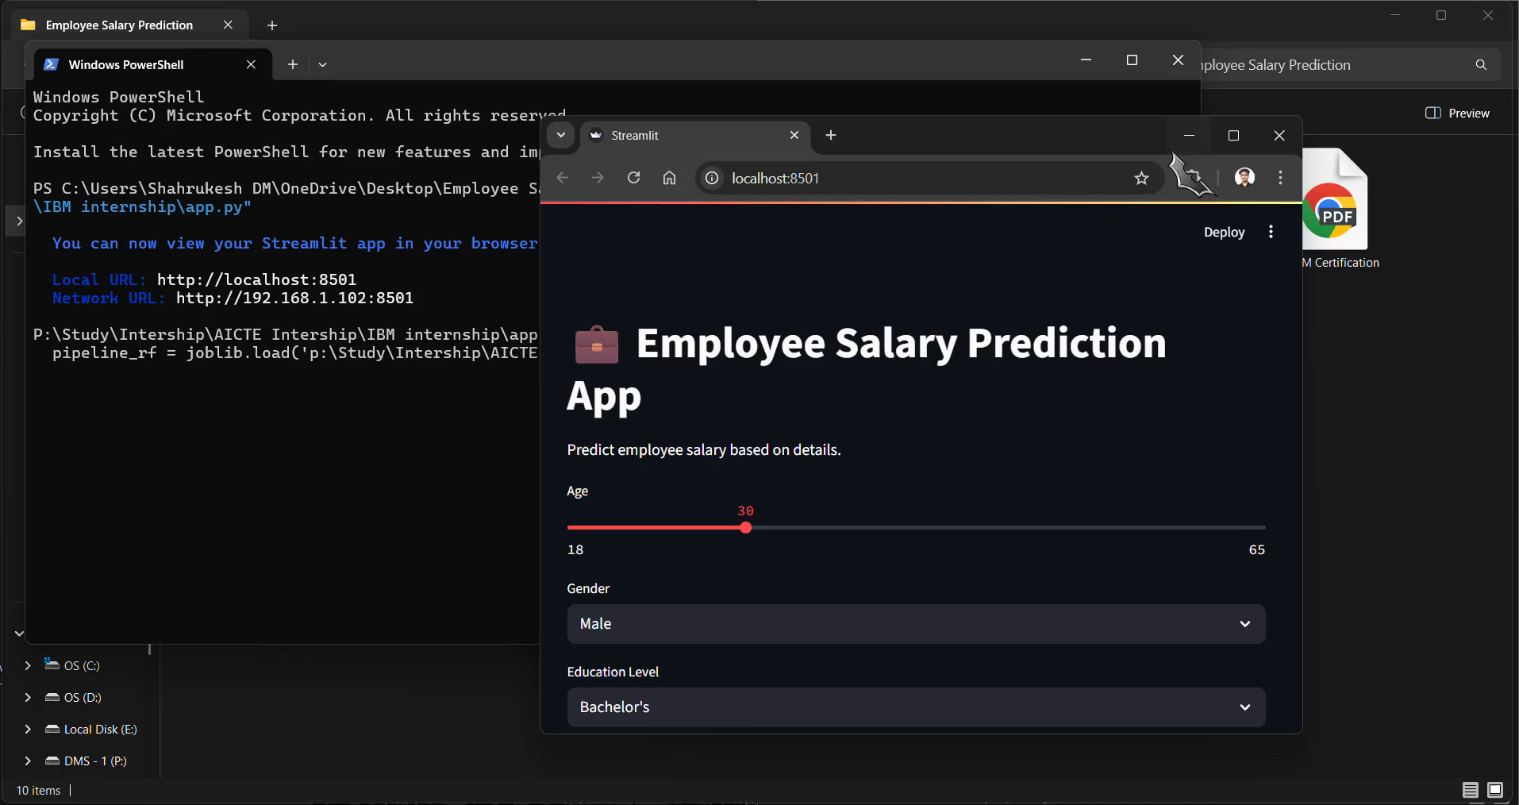
Result - Video
https://github.com/Shahrukesh/Employee-Salary-Prediction.git

Slide 6
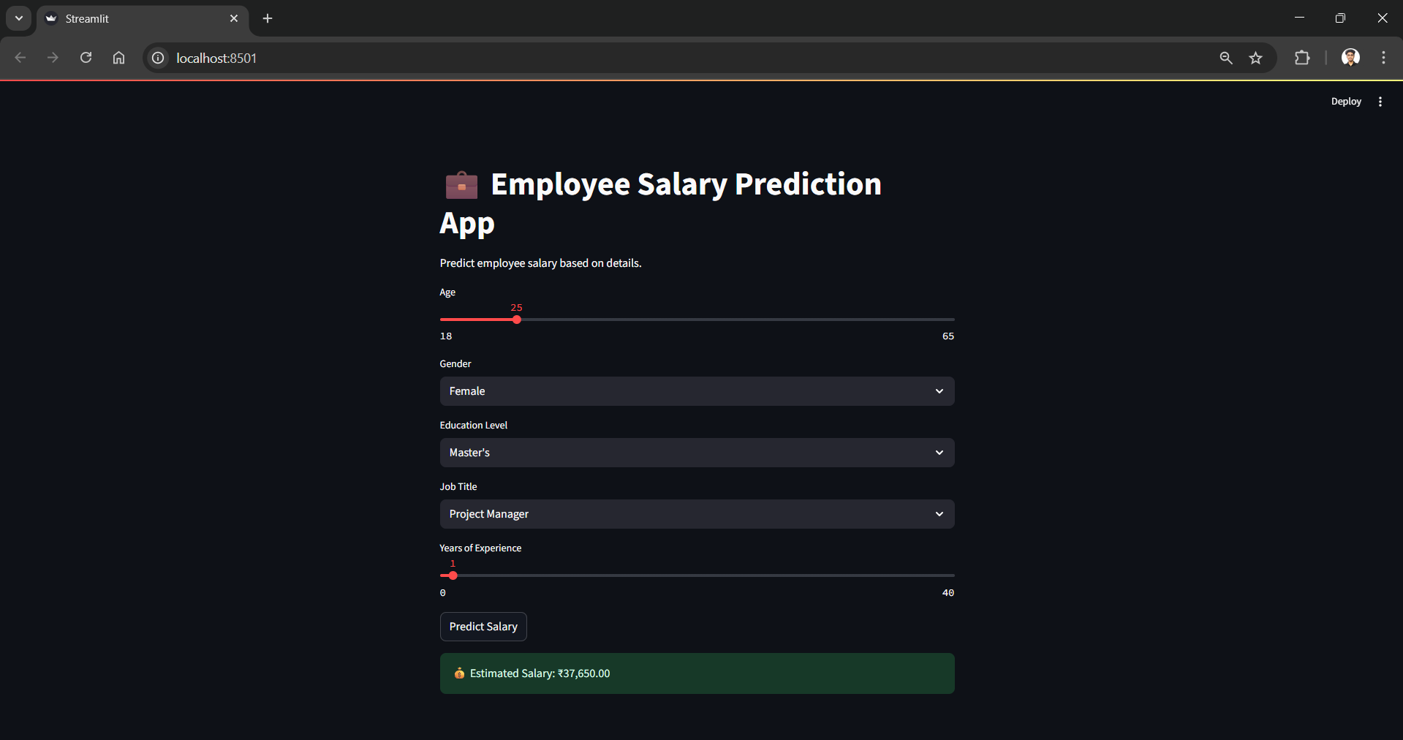
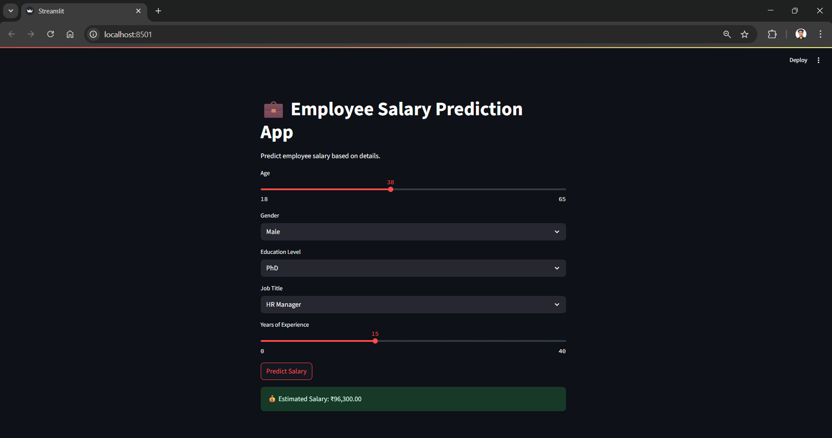
Result
https://github.com/Shahrukesh/Employee-Salary-Prediction.git

Slide 7
Conclusion
Built a robust Random Forest model for salary prediction.
Streamlit app ensures accessibility for HR users.
Outperformed Linear Regression in accuracy.
Challenges: Handling high-cardinality Job Titles.
Future: Add features, mitigate bias, enhance scalability.

Slide 8
Future scope(Optional)
Add features: Location, industry
Test advanced models (e.g., XGBoost).
Integrate real-time HR data.
Optimize for larger datasets.
Mitigate biases for fair predictions.

Slide 9
References
Pandas: https://pandas.pydata.org/docs/
Scikit-learn: https://scikit-learn.org/stable/
Streamlit: https://docs.streamlit.io/
Matplotlib: https://matplotlib.org/stable/contents.html
Seaborn: https://seaborn.pydata.org/

Slide 10
THANK YOU

